Slide 1


Chapter 11:
Structured Data

Slide 2
11.2
Combining Data into Structures

Slide 3
Combining Data into Structures
Structure: C++ construct that allows multiple variables to be grouped together
General Format:
  struct <structName>
  {
  type1 field1;
  type2 field2;
  . . .
  };

Slide 4
Example struct Declaration
  struct Student
  {
  int studentID;
  string name;
  short yearInSchool;
  double gpa;
  };
structure tag
structure members

Slide 5
struct Declaration Notes
Must have ; after closing }
struct names commonly begin with uppercase letter

Slide 6
Defining Variables
struct declaration does not allocate memory or create variables
To define variables, use structure tag as type name:
  Student bill;
bill
studentID
name
yearInSchool
gpa

Slide 7
11.3
Accessing Structure Members

Slide 8
Accessing Structure Members
Use the dot (.) operator to refer to members of struct variables:
  cin >> stu1.studentID;
  getline(cin, stu1.name);
  stu1.gpa = 3.75;
Member variables can be used in any manner appropriate for their data type
11-<number>

Slide 9
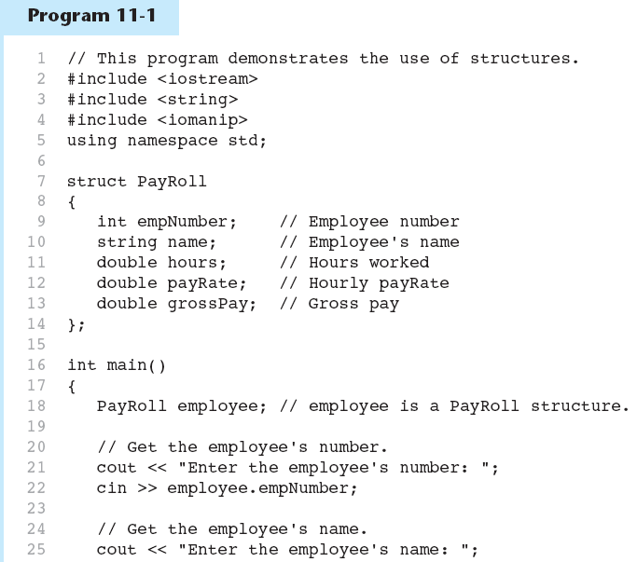

Slide 10
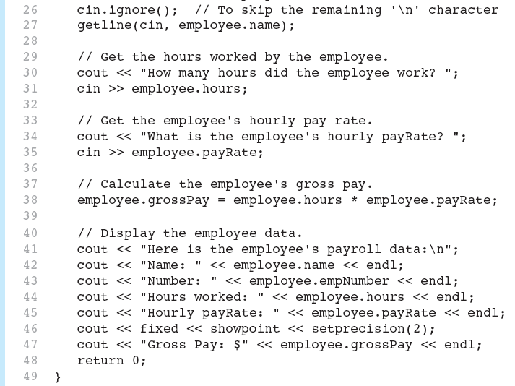

Slide 11
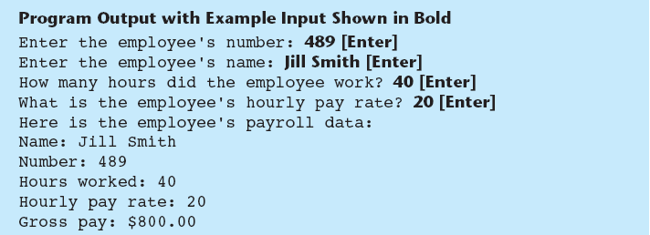

Slide 12
Displaying a struct Variable
To display the contents of a struct variable, must display each field separately, using the dot operator:
  cout << bill; // won’t work
  cout << bill.studentID << endl;
  cout << bill.name << endl;
  cout << bill.yearInSchool;
  cout << " " << bill.gpa;

Slide 13
Comparing struct Variables
Must compare on a field basis:
  if (bill.studentID ==
  william.studentID)
  ...

Slide 14
11.4
Initializing a Structure

Slide 15
Initializing a Structure
struct variable can be initialized when defined:
struct Student
{
int studentID;
string name;
short yearInSchool;
double gpa;
};
Student s = {11465, "Joan", 2, 3.75};

Slide 16
struct Student
{
int studentID;
string name;
short yearInSchool;
double gpa;
};
Student s = {11465, "Joan", 2, 3.75};
The first value 11465 goes in the first field, studentID
The second value "Joan" in the second field, name.
And so forth, in order.

Slide 17
More on Initializing a Structure
May initialize only the initial members:
  Student bill = {14579};
Cannot skip over members:
  Student s = {1234, "John", ,
  2.83}; // illegal
Cannot initialize in the structure declaration, since this does not allocate memory

Slide 18
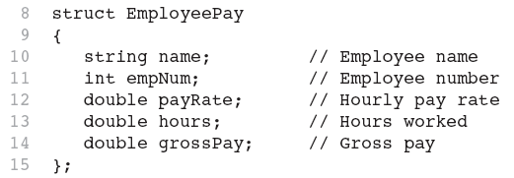
Excerpts From Program 11-3

Slide 19
11.5
Arrays of Structures

Slide 20
Arrays of Structures
Structures can be defined in arrays
Can be used in place of parallel arrays
const int NUM_STUDENTS = 20;
Student stuList[NUM_STUDENTS];
Individual structures accessible using subscript notation
Fields within structures accessible using dot notation:
  cout << stuList[5].studentID;

Slide 21
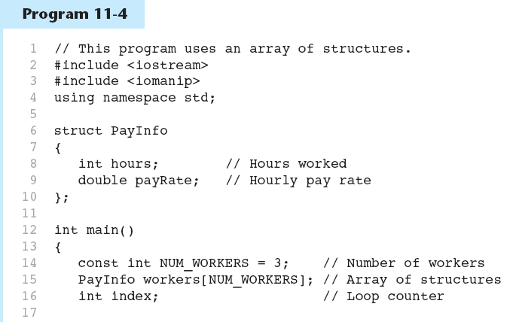

Slide 22
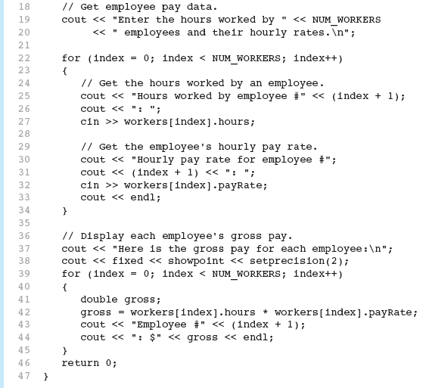

Slide 23
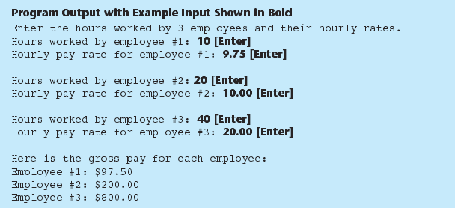

Slide 24
11.6
Nested Structures

Slide 25
Nested Structures
A structure can contain another structure as a member:
  struct PersonInfo
  { string name,
  address,
  city;
  };
  struct Student
  { int studentID;
  PersonInfo pData;
  short yearInSchool;
  double gpa;
  };

Slide 26
Members of Nested Structures
Use the dot operator multiple times to refer to fields of nested structures:
  Student s;
  s.pData.name = "Joanne";
  s.pData.city = "Tulsa";

Slide 27
11.7
Structures as Function Arguments

Slide 28
Structures as Function Arguments
May pass members of struct variables to functions:
  computeGPA(stu.gpa);
May pass entire struct variables to functions:
  showData(stu);
Can use reference parameter if function needs to modify contents of structure variable
Could also use an address parameter

Slide 29
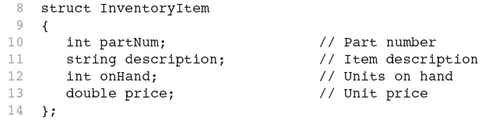
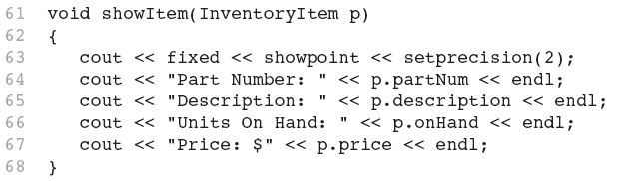
Excerpts from Program 11-6

Slide 30
Structures as Function Arguments - Notes
Using value parameter for structure can slow down a program, waste space
Using a reference parameter will speed up program, but function may change data in structure
Using a const reference parameter allows read-only access to reference parameter, does not waste space, speed

Slide 31
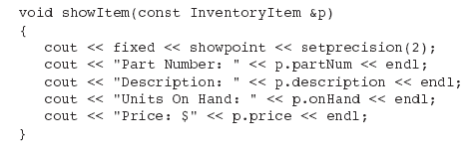
Revised showItem Function

Slide 32
11.8
Returning a Structure from a Function

Slide 33
Returning a Structure from a Function
Function can return a struct:
  Student getStudentData(); // prototype
  stu1 = getStudentData(); // call
The value of the structure is returned
Function must define a local structure
  for internal use
  for use with return statement

Slide 34
Returning a Structure from a Function - Example
  Student getStudentData()
  { Student tempStu;
  cin >> tempStu.studentID;
  getline(cin, tempStu.pData.name);
  getline(cin, tempStu.pData.address);
  getline(cin, tempStu.pData.city);
  cin >> tempStu.yearInSchool;
  cin >> tempStu.gpa;
  return tempStu;
  }

Slide 35
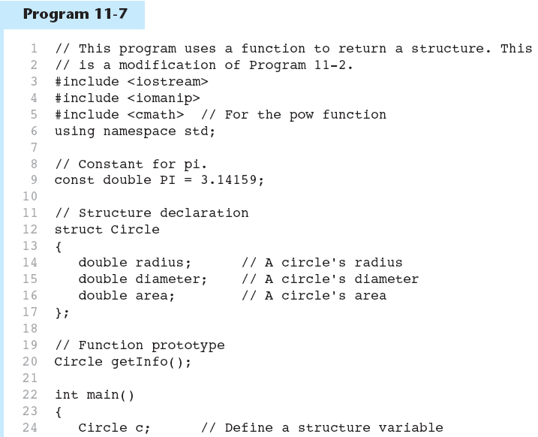

Slide 36
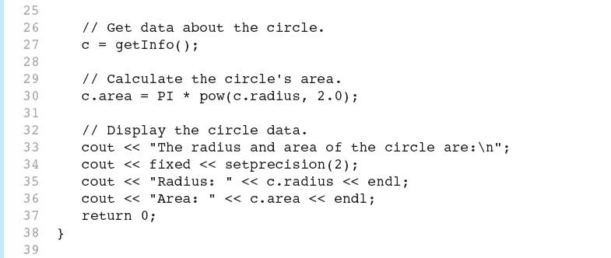

Slide 37
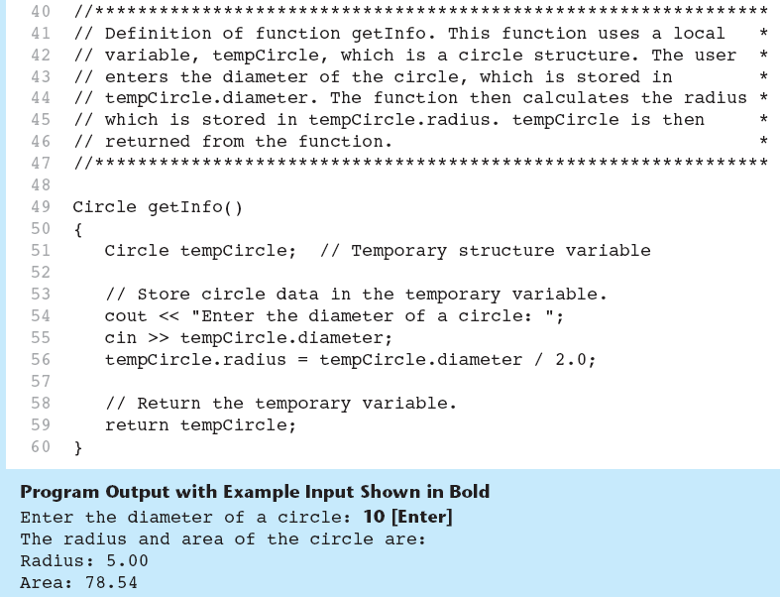

Slide 38
11.9
Pointers to Structures

Slide 39
Pointers to Structures
A structure variable has an address
Pointers to structures are variables that can hold the address of a structure:
  Student *stuPtr;
Can use & operator to assign address:
  stuPtr = & stu1;
Structure pointer can be a function parameter
11-<number>

Slide 40
Accessing Structure Members via Pointer Variables
There are the following two equivalent use of operators to dereference a pointer to a structure and access a field in the structure:
Must use () to dereference pointer variable, not field within structure:
  cout << (*stuPtr).studentID;
Can use structure pointer operator to eliminate () and use clearer notation:
  cout << stuPtr->studentID;
11-<number>

Slide 41
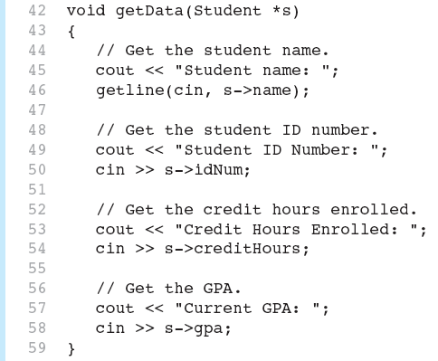
From Program 11-8

Slide 42
Dynamically Allocating a Structure
  Circle *cirPtr;
  cirPtr = new Circle;
  cirPtr->radius = 10;
  cirPtr->diameter = 20;
  cirPtr->area = 314.159;
11-<number>

Slide 43
Dynamically Allocating an Array of Structures
  Circle *cirAry;
  cirAry = new Circle[5];
  for (int i = 0; i < 5; i++)
  {
  cout << "Enter radius: ";
  cin >> cirAry[i].radius;
  }
11-<number>

